Slide 1
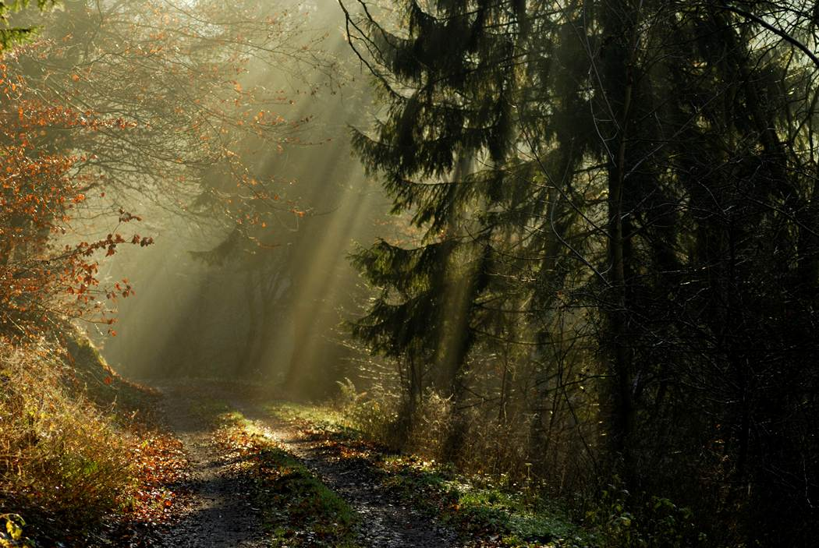

Programs
In 2012, The Trek will provide speakers for many of the Retreat Weekends and Chapels at Crescent Lake Bible Camp. These include: New Year's Blast (Grades K - 6), College Retreat (Ages 18 - 25), Sr. High Ice Blast (Grades 9 - 12), Jr. High Snow Blast (Grades 6 - 9) and the Pastor / Youth Pastor Weekend. We would like to thank Crescent Lake Bible Camp for their generous support and assistance as we bring our updated programs online.
In addition, we will begin hosting our own Retreats at our partner facilities. The weekend programs will focus on the basics of The Trek, including: "Perceptions and Expectations", "Self-Talk", "Understanding Feelings" and more. Week-long camps will offer the complete program in a compact version.
Each program consists of presentations, round-table discussions, peer interactions and times of sharing. Recreational activities will be hosted by our partner facilities and vary depending on location. Please note that these programs are limited in numbers and filled on a first-come / first-served basis.
Women's Retreat @ Crescent Lake (March 16 - 18)
Men's Retreat @ Crescent Lake (April 20 - 22)
Sr. High Youth Camp @ Crescent Lake (June 17 - 23)
Freedom Week Family Camp @ Crescent Lake (July 1 - 7)
Jr. High Youth Camp @ Crescent Lake (August 12 - 18)
Family Weekend @ Crescent Lake (October 26 - 28)
We will be adding more events, so please stop back often!
The Trek
What Is The Trek?
Home
Programs
History
Get Started…
Contact Us

